Slide 1
Module Seven: Hot topics in Service Computing - Cloud -

Slide 2
Topic 3: Cloud Stakeholders, Cloud Standardization, Cloud Computing Reference Architecture

Slide 3
Intended learning outcomes
After completing this topic, you will be able to:
List different cloud stakeholders
Understand the roles of the cloud stakeholders
Be aware of the concerns of the cloud stakeholders

Slide 4
What is a stakeholder
Anyone who has interest in the value cloud computing technology creates
Anyone who is affected positively by it
Anyone who is affected negatively by it

Slide 5
Who are cloud stakeholders?

Slide 6
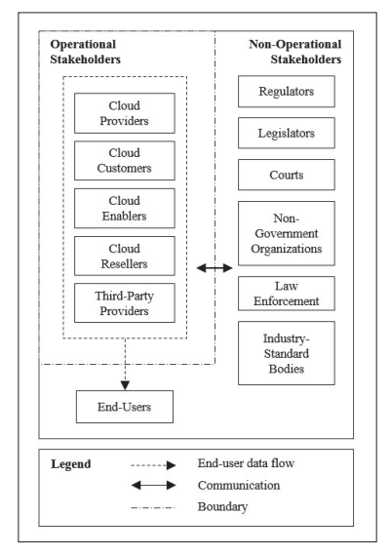
Cloud Stakeholders

Slide 7
Operational stakeholders
Stakeholders who perform and conduct cloud operations

Slide 8

Operational stakeholders
Cloud providers
Cloud customers
End-users
Cloud enablers
Cloud resellers
Third-party providers

Slide 9
Cloud provider
A cloud service provider is an information technology (IT) company that provides its customers with computing resources over the internet and delivers them on-demand
Popular examples of cloud service providers include:
Amazon Web Services (AWS)
Microsoft Azure
Google Cloud
Alibaba Cloud
IBM Cloud
Salesforce

Slide 10
Cloud provider concerns
Resource utilization
Energy efficiency
Metering
Providing resources
Meet end user requirements
…

Slide 11
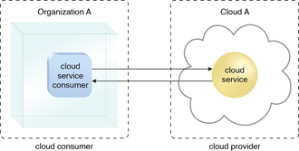
Cloud customer/consumer
A cloud customer (cloud consumer) represents a person or organization that maintains a business relationship with, and uses the service from a cloud provider

Slide 12
Cloud customer/consumer
A cloud customer browses the service catalog from a cloud provider, requests the appropriate service, sets up service contracts with the cloud provider, and uses the service
The cloud consumer may be billed for the service provisioned, and needs to arrange payments accordingly

Slide 13
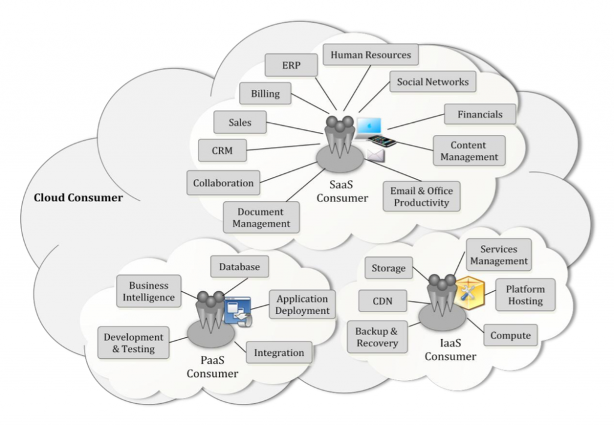
Cloud services available to a cloud consumer

Slide 14
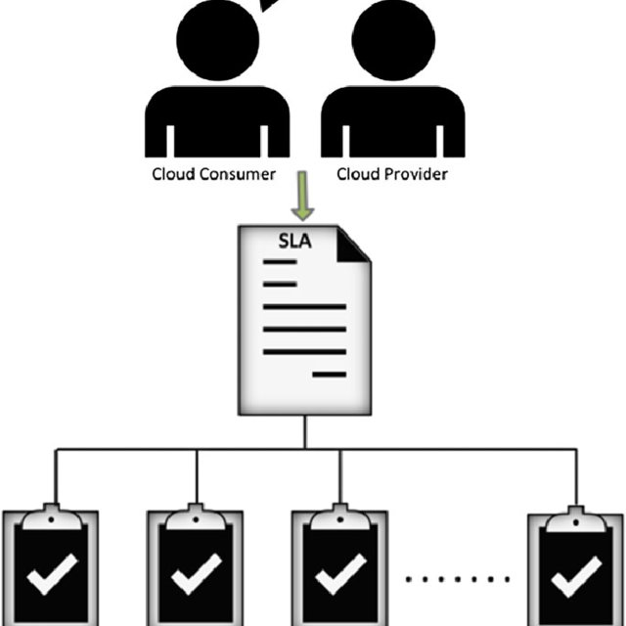
SLA
A cloud customer has a formal contract or arrangement with a cloud provider to use IT resources made available by the cloud provider
A service-level agreement is a commitment between a service provider and a client

Slide 15
SLA
Cloud consumers need SLAs to specify the technical performance requirements fulfilled by a cloud provider
quality of service
security
remedies for performance failures
A cloud provider may also list in the SLAs limitations and obligations that cloud consumers must accept
Typically, a cloud provider’s pricing policy and SLAs are non-negotiable, unless the customer expects heavy usage and might be able to negotiate for better contracts.

Slide 16
Operational stakeholders
Cloud providers
Cloud customers
End-users
Cloud enablers
Cloud resellers
Third-party providers

Slide 17
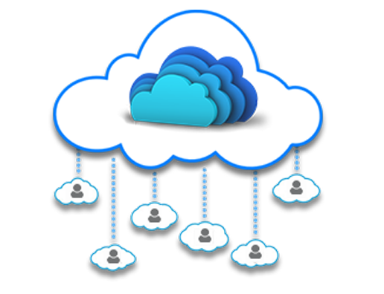
End-user
People who simply use cloud services on an everyday basis
employees inside a company who are end users of the company’s cloud services
general public, connecting to cloud services designed for massive public consumption
Most end users have no special technical skills

Slide 18
End user concerns
Security
Privacy
High availability
Ease of use
…

Slide 19
Operational stakeholders
Cloud providers
Cloud customers
End-users
Cloud enablers
Cloud resellers
Third-party providers

Slide 20
Example - Rain Classroom - 雨课堂
Rain Classroom is a cloud computing tool, which is jointly developed by Tsinghua University and XueTangX.
HITSZ purchased a school membership that allows HITSZ staff and students to access Rain Classroom functions
In this scenario
Who is cloud provider?
Who is cloud customer?
Who is cloud end-user?

Slide 21
Operational stakeholders
Cloud providers
Cloud customers
End-users
Cloud enablers
Cloud resellers
Third-party providers

Slide 22
Cloud enabler
Cloud enablers are information technology (IT) firms that create hardware, software, storage devices, networking equipment, and other related cloud environment components

Slide 23
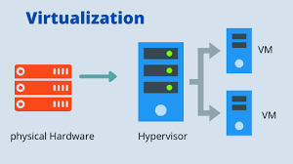
Cloud enabler example
An organization that manufactures virtualization hypervisors that enable virtual machines (VMs) is a cloud enabler
A hypervisor is hardware, software, or firmware capable of creating virtual machines and then managing and allocating resources to them

Slide 24
Cloud enabler vs cloud provider
A cloud enabler is different from a cloud service provider
Cloud service providers use the technologies built by cloud enablers to deliver cloud-based services to end-users

Slide 25
Why are cloud enablers important?
Cloud enablers serve as the backbone for cloud products and services offered by a cloud provider
Developing a scalable, reliable, and robust cloud computing service is complex and requires many technical skills and hard work
Let a company build, deploy, integrate, and deliver cloud computing solutions

Slide 26
Why are cloud enablers important?
Cloud enablers make it possible for the cloud customers to move their resources to the cloud
Cloud enablers play a critical role in coming up with cloud strategies, service selection, and cloud app development and infrastructure establishment
A cloud enabler is a huge part of building, deploying, integrating, and delivering cloud computing solutions

Slide 27
Cloud reseller
A cloud reseller is a service provider who buys cloud computing products and services from major providers like AWS or Google, which they then resell to their own customers

Slide 28
Cloud reseller
A cloud computing reseller acts as a valued added reseller (VAR) when they combine and/or complement the cloud product/service with additional value or functionality.

Slide 29
Cloud reseller - example
A cloud computing reseller combines their photo editing software with cloud provider’s storage service to enhance the value of software product

Slide 30
Third-party providers
A company that provides cloud services to another company without a contract
When contracting for cloud-computing services, one challenge is that there may be more parties involved than the cloud customer and the cloud provider

Slide 31



Third-party providers - example
A cloud user uses services of a SaaS provider Dropbox

Slide 32
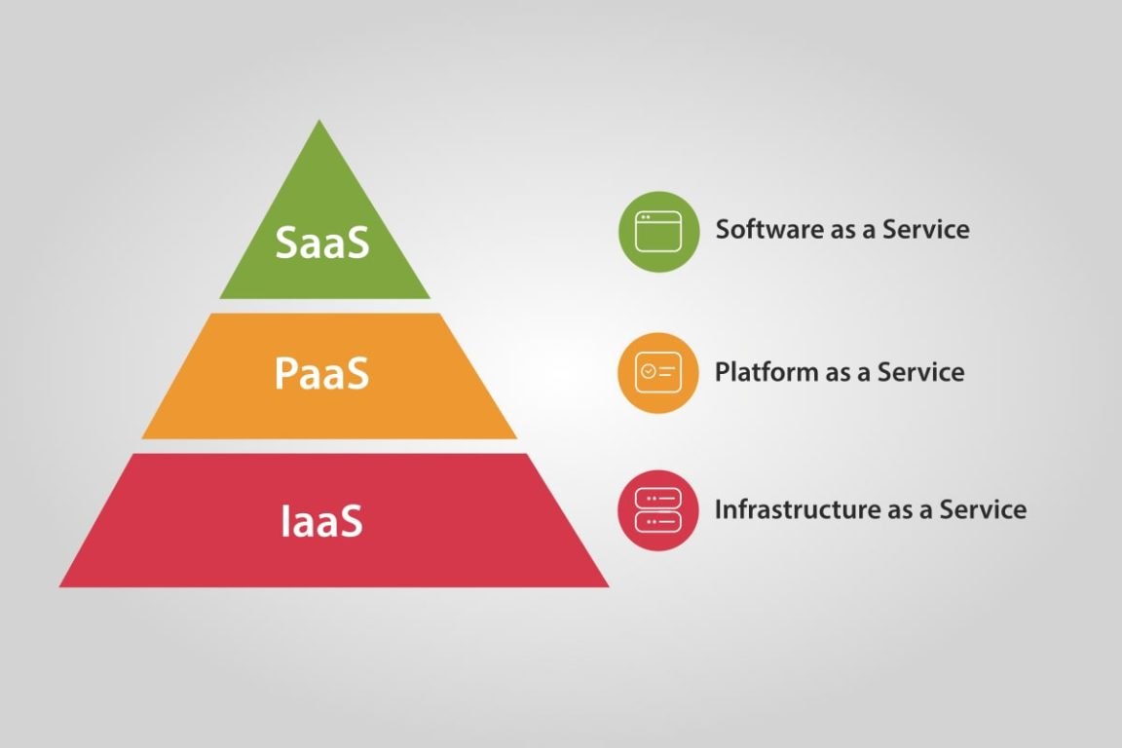


Third-party providers - example
Dropbox is running its service in the data center of a third-party IaaS vendor, Amazon Web Services

Slide 33
Third-party providers - example
In this scenario
Dropbox is a service provider
AWS is a third-party provider

Slide 34

Third-party providers - example
This can increase the complexity of a cloud-computing contract, especially in determining which provider is responsible for which action

Slide 35
Third-party provider challenges
The introduction of third parties can increase risk
It's essential for potential cloud customers to identify third parties before adopting a cloud service, thoroughly understand their roles and ensure that their responsibilities are effectively addressed in the contract

Slide 36
Cloud Stakeholders

Slide 37
Developing laws for cloud computing
Protecting the customers' and service provider's rights has become quite challenging for Cloud Computing
Different countries have their own specific jurisdiction, laws, and regulations.
There are diverse stakeholders that ensure the development of efficient and fair laws for both the customers and service providers

Slide 38
Legal issues in cloud computing
Legal issues that can arise “in the cloud” include
liability for copyright infringement
data breaches
security violations, privacy violations
data loss, data management
hacking, cybersecurity
…
There are diverse stakeholders that ensure that legal standards, regulations, and norms relating to cloud computing are being developed

Slide 39
Highly regulated industries
Highly regulated industries face specific industry regulatory requirements, standards and laws
Healthcare
Finance
Government
…
There are diverse stakeholders that ensure that organizations operating within these industries are compliant with the requirements

Slide 40
Cloud Stakeholders

Slide 41
Non-Operational Stakeholders
Cloud computing standards and laws in China
International cloud computing standards

Slide 42
Cloud computing standards and laws in China

Slide 43

Chinese cloud providers
Most popular Chinese cloud providers
Alibaba Cloud
Tencent Cloud
China Telecom Cloud
Huawei Cloud
Baidu Cloud

Slide 44
International cloud providers in China
International cloud providers have to operate in the Chinese market by cooperating with domestic service providers
Examples
AWS is run by Sinnet in Beijing and by Ningxia Western Cloud Data Technology (NWCD) in Ningxia
Microsoft Azure is branded as Azure China and operated locally by 21Vianet

Slide 45
Security related regulation
China Cybersecurity Law (CSL) - 2017
all network operators must comply with the CSL
Classified Protection of Cybersecurity Scheme(Multi-Level Protection Scheme (MLPS) - 2008/2019
MLPS was first introduced in 2008 and updated to MLPS 2.0 in 2019
a regulatory scheme designed to protect the cybersecurity of networks and systems in China
it is compulsory for all companies and individuals that own, operate, or provide services relating to network and corresponding system components in China to follow the national standards under the MLPS scheme
China Data Security Law (DSL) - 2021
stipulates the security of data related activities in mainland China such as collection, storage, processing, usage, provision, trading and publishing, etc.

Slide 46
Privacy related regulation
China Personal Information Protection Law (PIPL) – 2021
It is the first law framework over personal data protection in mainland China to protect personal information rights and interests, regulate the processing of personal information, and promote the reasonable use of personal information
regulates the data related activities pertaining to personal data
Other than PIPL, the data protection requirements can also be found in various other regulations

Slide 47
Financial industry standards on cloud computing technology
The National Financial Standardization Technical Committee ('NFSTC') announced, on 27 October 2020, that the People's Bank of China has released three financial industry standards on cloud computing
Technical Framework of Cloud Computing Technology Financial Application Specification (JR/T 0166-2020) ('the Cloud Computing Framework Specification')
Cloud Computing Technology Financial Application Specification Security Technical Requirements (JR/T 0167-2020) ('the Cloud Computing Security Specification')
focuses on the potential risks of cloud computing financial applications
outlines requirements for data security and security management
proposes policies
Cloud Computing Technology Financial Application Specification Disaster Recovery (JR/T 0168-2020) ('Cloud Computing Disaster Recovery Specification')
stipulates technical requirements that all cloud computing participants should follow when measuring the cloud computing platform's disaster tolerance capability and carrying out the disaster recovery work of the cloud computing platform

Slide 48
International cloud computing standards

Slide 49



International standard organizations
ISO
International Organization for Standardization
ITU
International Telecommunication Union
IEC
International Electrotechnical Commission

Slide 50
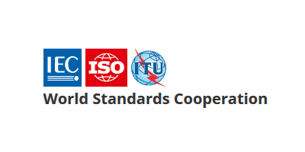
World Standards Cooperation alliance
Together, these three organizations have formed the World Standards Cooperation alliance

Slide 51
ISO - The International Organization for Standardization
An international standard development organization
It works in 167 countries
Develops and publishes standardization in all technical and nontechnical fields other than electrical and electronic engineering
Electronic engineering standards are responsibility of IEC - International Electrotechnical Commission

Slide 52
ISO Standardization process
ISO has 804 technical committees and subcommittees concerned with standards development
International Standards are developed by ISO technical committees (TC) and subcommittees (SC) by a process with six steps
Stage 1: Proposal stage
Stage 2: Preparatory stage
Stage 3: Committee stage
Stage 4: Enquiry stage
Stage 5: Approval stage
Stage 6: Publication stage
As of April 2022, the ISO has developed over 24,261 standards, covering everything from manufactured products and technology to food safety, agriculture, and healthcare

Slide 53
Joint technical committee with IEC
ISO/IEC JTC 1
ISO has a joint technical committee (JTC) with the International Electrotechnical Commission (IEC) to develop standards relating to information technology

Slide 54
ISO/IEC JTC 1 Scope and mission
Develop, maintain, promote and facilitate IT standards required by global markets meeting business and user requirements concerning:
The design and development of IT systems and tools
The performance and quality of IT products and systems
The security of IT systems and information
The portability of application programs
The interoperability of IT products and systems
The unified tools and environments
The harmonized IT vocabulary
The user-friendly and ergonomically-designed user interfaces

Slide 55
ISO/IEC JTC 1 Structure
Most work on the development of standards is done by subcommittees (SCs), each of which deals with a particular field
Subcommittee dealing with the field of cloud computing is called ISO/IEC JTC 1/SC 38
Most of these subcommittees have several working groups (WGs)

Slide 56
Standardization of cloud computing

Slide 57
Standardization of cloud computing - definition
The implementation of standards in cloud computing industry

Slide 58
Where are technical standards developed?
The main technical committees active in Cloud Computing standardization
ISO/IEC JTC 1/SC 38 “Cloud Computing and Distributed Platforms”
ITU-T/SG 13 “Future networks and emerging network technologies”
ISO/IEC JTC 1/SC 27 “Information security, cybersecurity and privacy protection”
ITU-T/SG 17 “Security”

Slide 59
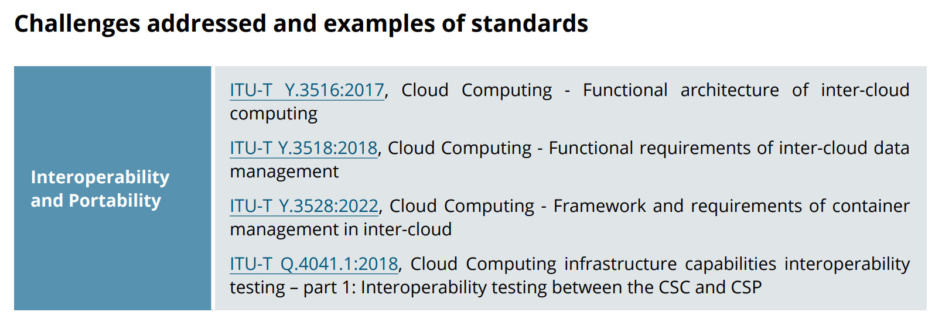
ITU-T/SG 13 “Future networks and emerging network technologies”

Slide 60
Where are technical standards developed?
The main technical committees active in Cloud Computing standardization
ISO/IEC JTC 1/SC 38 “Cloud Computing and Distributed Platforms”
ITU-T/SG 13 “Future networks and emerging network technologies”
ISO/IEC JTC 1/SC 27 “Information security, cybersecurity and privacy protection”
ITU-T/SG 17 “Security”

Slide 61
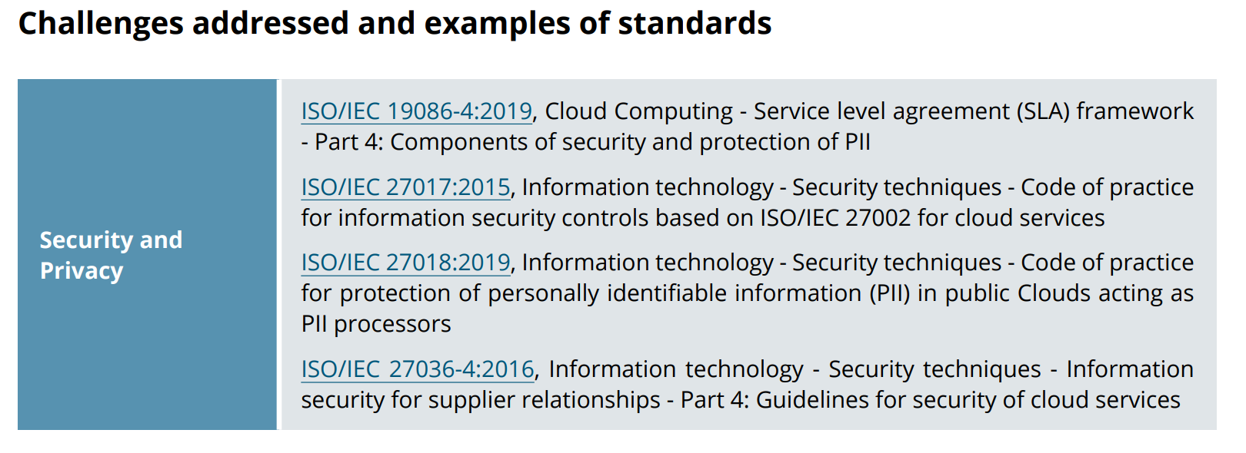
ISO/IEC JTC 1/SC 27 “Information security, cybersecurity and privacy protection”

Slide 62
Where are technical standards developed?
The main technical committees active in Cloud Computing standardization
ISO/IEC JTC 1/SC 38 “Cloud Computing and Distributed Platforms”
ITU-T/SG 13 “Future networks and emerging network technologies”
ISO/IEC JTC 1/SC 27 “Information security, cybersecurity and privacy protection”
ITU-T/SG 17 “Security”

Slide 63
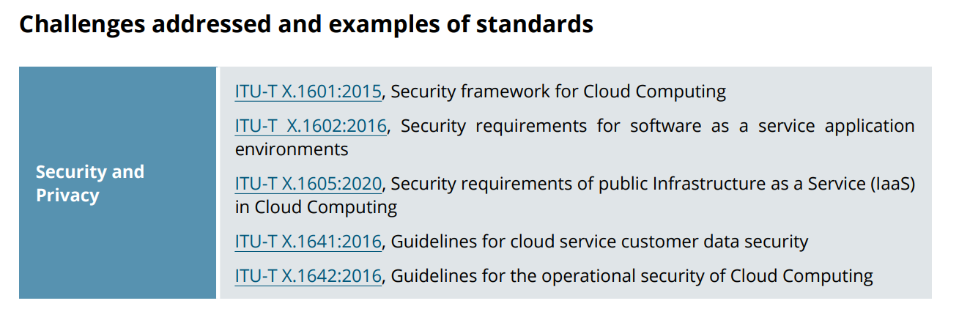
ITU-T/SG 17 “Security”

Slide 64
Where are technical standards developed?
The main technical committees active in Cloud Computing standardization
ISO/IEC JTC 1/SC 38 “Cloud Computing and Distributed Platforms”
ITU-T/SG 13 “Future networks and emerging network technologies”
ISO/IEC JTC 1/SC 27 “Information security, cybersecurity and privacy protection”
ITU-T/SG 17 “Security”

Slide 65
ISO/IEC JTC 1/SC 38 “Cloud Computing and Distributed Platforms”

Slide 66
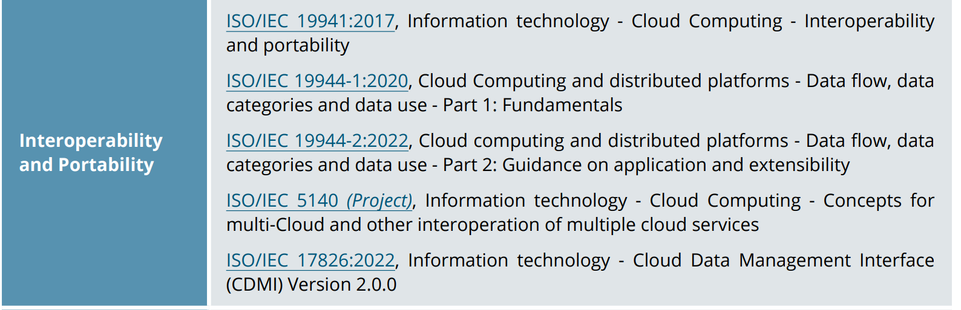
ISO/IEC JTC 1/SC 38 “Cloud Computing and Distributed Platforms”

Slide 67
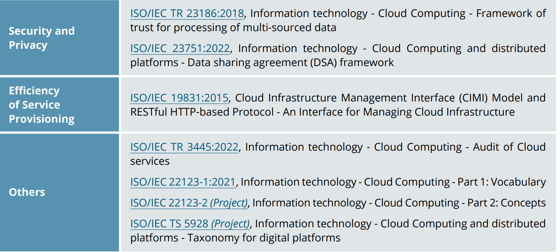
ISO/IEC JTC 1/SC 38 “Cloud Computing and Distributed Platforms”

Slide 68
ISO/IEC JTC 1/SC 38 “Cloud Computing and Distributed Platforms”
We will introduce the works of this subcommittee in more details

Slide 69
ISO/IEC JTC 1/SC 38
ISO/IEC JTC 1/SC 38 Cloud Computing and Distributed Platforms
A standardization subcommittee
Develops standards to assist organizations in specifying, acquiring and applying Cloud Computing and distributed platform technologies and services.

Slide 70
Member countries
29 participating members
Australia, Austria, Belgium, Brazil, Canada, China, Denmark, Finland, France, Germany, India, Ireland, Israel, Italy, Japan, Republic of Korea, Luxembourg, Netherlands, Poland, Portugal, Russian Federation, Singapore, Slovakia, South Africa, Spain, Sweden, Switzerland, United Kingdom, and United States of America
8 observing members

Slide 71
Scope and mission
The scope of ISO/IEC JTC 1/SC 38 is the “Standardization in the area of Cloud Computing and Distributed Platforms”.
Foundational concepts and technologies
Operational issues
Interactions among Cloud Computing systems and with other distributed systems

Slide 72
ISO/IEC JTC 1/SC 38 Structure
ISO/IEC JTC 1/SC 38 is made up of two working groups (WGs)
Each working group carries out specific tasks in standards development within the field of Cloud Computing and Distributed Platforms
Working Group | Working Area
ISO/IEC JTC 1/SC 38/WG 3 | Cloud Computing Fundamentals (CCF)
ISO/IEC JTC 1/SC 38/WG 5 | Cloud Computing Data and its Flow (CCDF)

Slide 73
WG 3 - CLOUD COMPUTING FUNDAMENTALS (CCF)
Cloud Computing Fundamentals (CCF)
Projects related to Cloud Computing Service Agreements
Projects related to fundamental concepts, terminology and definitions for Cloud Computing
Projects related to guidance on use of international standards in the development of policies that govern or regulate cloud service providers and cloud services, and policies that govern the use of cloud services in enterprise organizations
Establish liaisons and collaborate with other entities within JTC 1, SDOs and consortia performing work related to Cloud Computing

Slide 74
WG 5 – DATA IN CLOUD COMPUTING AND RELATED TECHNOLOGIES
Cloud Computing Data and its Flow (CCDF)
Standardization in the area of data in cloud computing, distributed platforms, connected devices and related technologies
Establish liaisons and collaborate with other entities within and external to JTC 1 as appropriate

Slide 75
Standards developed by ISO/IEC JTC 1/SC 38
ISO/IEC JTC 1/SC 38 published many standards in the area of
Cloud Computing
Web Services
Service Oriented Architecture (SOA)

Slide 76
Standards developed by ISO/IEC JTC 1/SC 38
ISO/IEC JTC 1/SC 38 has 15 published standards in the area of
Cloud Computing
Web Services
Service Oriented Architecture (SOA)

Slide 77
ISO/IEC 17203
Information technology — Open Virtualization Format (OVF) specification
Specifies an open, secure, portable, efficient and extensible format for the packaging and distribution of software to be run in virtual machines

Slide 78
ISO/IEC 17788
Information technology -- Cloud computing -- Overview and vocabulary
Provides an overview of cloud computing along with a set of terms and definitions

Slide 79
ISO/IEC 17789
Information technology — Cloud computing — Reference architecture
Specifies the cloud computing reference architecture (CCRA)
cloud computing roles
cloud computing activities
cloud computing functional components and their relationships

Slide 80
ISO/IEC 17826
Information technology – Cloud Data Management Interface (CDMI)
Specifies the interface to access cloud storage and to manage the stored data

Slide 81
ISO/IEC 19086-1
Information technology — Cloud computing — Service level agreement (SLA) framework — Part 1: Overview and concepts
Establishes a set of common cloud SLA building blocks (concepts, terms, definitions, contexts) that can be used to create cloud Service Level Agreements (SLAs).

Slide 82
ISO/IEC 19086-2
Cloud computing — Service level agreement (SLA) framework — Part 2: Metric model
Establishes common terminology, defines a model for specifying metrics for cloud SLAs, and includes applications of the model with examples.

Slide 83
ISO/IEC 19086-3
Information technology — Cloud computing — Service level agreement (SLA) framework — Part 3: Core conformance requirements
Specifies the core conformance requirements for service level agreements (SLAs) for cloud services based on ISO/IEC 19086‑1 and guidance on the core conformance requirements.

Slide 84
ISO/IEC 19941
Information technology — Cloud computing — Interoperability and portability
Specifies cloud computing interoperability and portability types, the relationship and interactions between these two cross-cutting aspects of cloud computing and common terminology and concepts used to discuss interoperability and portability, particularly relating to cloud services.

Slide 85
ISO/IEC 19944
Information technology — Cloud computing — Cloud services and devices: Data flow, data categories and data use
Extends the existing cloud computing vocabulary and reference architecture in ISO/IEC 17788 and ISO/IEC 17789 to describe an ecosystem involving devices using cloud services

Slide 86
ISO/IEC TR 22678
Information technology — Cloud computing — Guidance for policy development
Provides guidance on the use of international standards as a tool in the development of those policies that govern or regulate cloud service providers (CSPs) and cloud services, and those policies and practices that govern the use of cloud services in organisations.

Slide 87
ISO/IEC TR 23186
Information technology — Cloud computing — Framework of trust for processing of multi-sourced data
Describes a framework of trust for the processing of multi-sourced data that includes data use obligations and controls, data provenance, chain of custody, security and immutable proof of compliance as elements of the framework.

Slide 88
Standards developed by ISO/IEC JTC 1/SC 38
ISO/IEC JTC 1/SC 38 has 15 published standards in the area of
Cloud Computing
Web Services
Service Oriented Architecture (SOA)

Slide 89
ISO/IEC 17963
Web Services for Management (WS-Management) Specification
Describes a Web services protocol based on SOAP for use in management‑specific domains

Slide 90
Standards developed by ISO/IEC JTC 1/SC 38
ISO/IEC JTC 1/SC 38 has 15 published standards in the area of
Cloud Computing
Web Services
Service Oriented Architecture (SOA)

Slide 91
ISO/IEC 17998
Information technology – SOA Governance Framework
Describes a framework for providing context and definitions related to SOA for organizations to use when deploying SOA governance.
Defines:
SOA Governance
SOA Governance Reference Model
SOA Governance Vitality Model

Slide 92
ISO/IEC 18384-1
Information technology — Reference Architecture for Service Oriented Architecture (SOA RA) — Part 1: Terminology and concepts for SOA
Establishes vocabulary, guidelines, and general technical principles underlying service oriented architecture (SOA), including principles relating to functional design, performance, development, deployment, and management.

Slide 93
ISO/IEC 18384-1
Information technology — Reference Architecture for Service Oriented Architecture (SOA RA) — Part 1: Terminology and concepts for SOA
Establishes vocabulary, guidelines, and general technical principles underlying service oriented architecture (SOA), including principles relating to functional design, performance, development, deployment, and management.

Slide 94
ISO/IEC 18384-2
Information technology — Reference Architecture for Service Oriented Architecture (SOA RA) — Part 2: Reference Architecture for SOA Solutions
Describes a Reference Architecture for SOA Solutions which applies to functional design, performance, development, deployment and management of SOA Solutions.

Slide 95
ISO/IEC 18384-3
Information technology — Reference Architecture for Service Oriented Architecture (SOA RA) — Part 3: Service Oriented Architecture ontology
Defines a formal ontology for service-oriented architecture (SOA), an architectural style that supports service orientation. The terms defined in this ontology are key terms from the vocabulary in ISO/IEC 18384-1.

Slide 96
ISO/IEC TR 30102
Information technology – Distributed Application Platforms and Services (DAPS) – General technical principles of Service Oriented Architecture
Describes general technical principles underlying SOA including principles relating to functional design, performance, development, deployment and management

Slide 97
Importance of foundational standards
Two foundational standards that deal with vocabulary and reference architecture
ISO/IEC 17788:2014 “Information technology — Cloud computing — Overview and vocabulary”
ISO/IEC 17789:2014 “Information technology — Cloud computing — Reference architecture”.
Essential for developing other standards

Slide 98
Importance of foundational standards
Two foundational standards that deal with vocabulary and reference architecture
ISO/IEC 17788:2014 “Information technology — Cloud computing — Overview and vocabulary”
ISO/IEC 17789:2014 “Information technology — Cloud computing — Reference architecture”.
Essential for developing other standards

Slide 99
Cloud Computing Reference Architecture

Slide 100
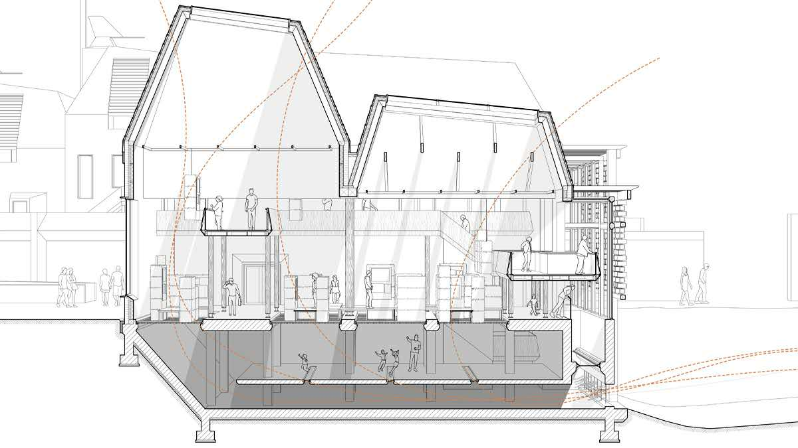
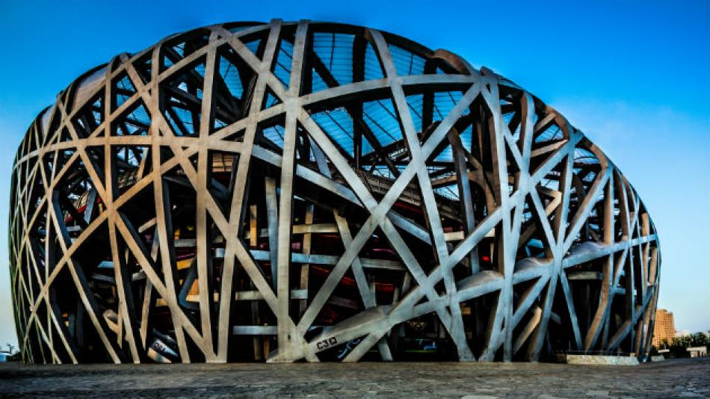
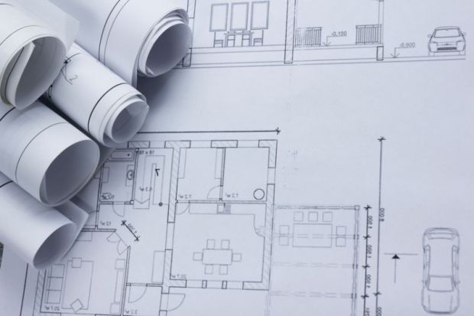

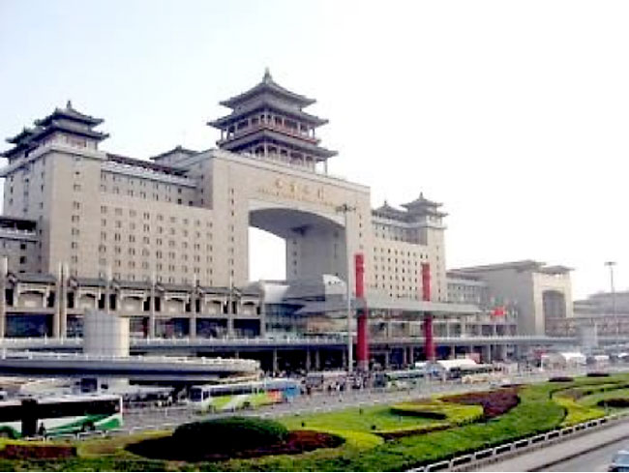
Architecture

Slide 101
Architecture
建筑 -建筑学
In English, the same word "Architecture" is used as a metaphor for many modern techniques or fields for structuring abstractions.
For example, systems architecture - 系统架构
In Chinese, these two meanings are reflected by different words

Slide 102
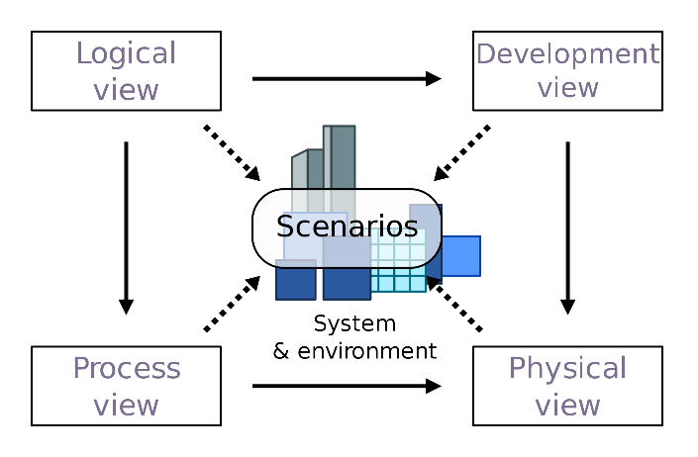
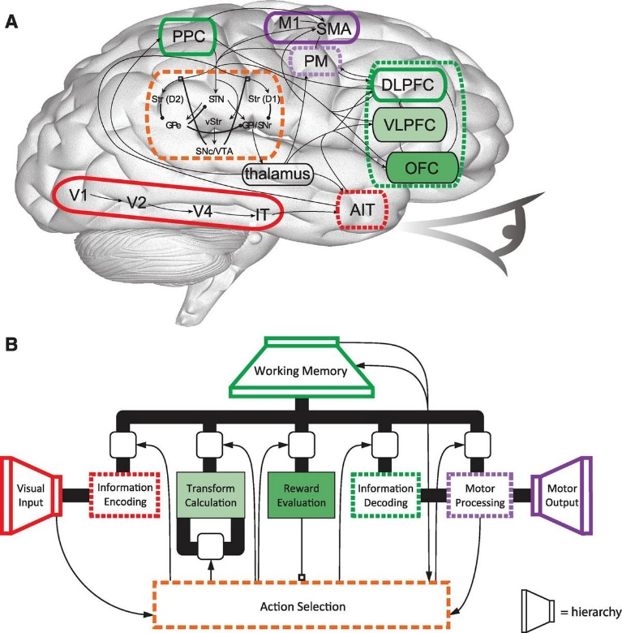
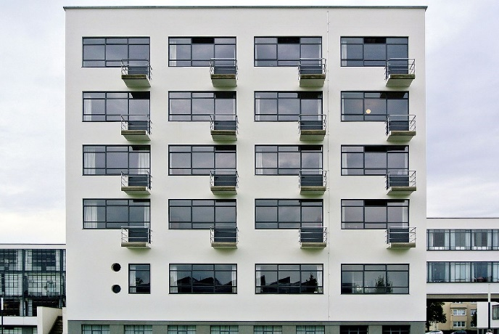
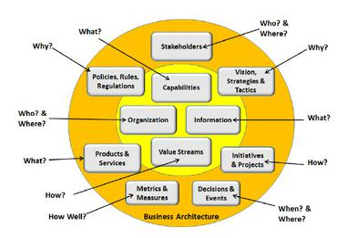
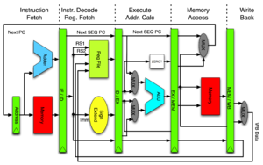
Architecture
The process of planning, designing and constructing structures
Building
Business
Cognitive
Computer
Software 软件架构
…..

Slide 103
What is Architecture?
The architecture of a system is the set of structures needed to reason about the system, which comprise elements, relations among them, and properties of both.

Slide 104
Reference Architecture
A reference architecture provides a template solution for an architecture for a particular domain
It also provides a common vocabulary with which to discuss implementations, often with the aim to stress commonality
It refers to any system in this domain
Not to a specific implementation of the system

Slide 105
Cloud Computing Reference Architecture
Defines the basic building blocks—architectural elements and their relationships—which make up the cloud
Cloud computing roles
Cloud computing activities
Cloud computing functional components and their relationships

Slide 106
Standards describing CCRA
Before 2010, cloud computing reference models were proposed by multiple cloud organizations, vendors, and federal agencies
Example: 2010 – CCRA developed by IBM
In 2011 CCRA developed by NIST was published
The team from NIST surveyed and completed an initial analysis of existing cloud computing reference models and developed a neutral model of architectural concepts
In 2014 ISO together with IEC published an international standard describing CCRA

Slide 107
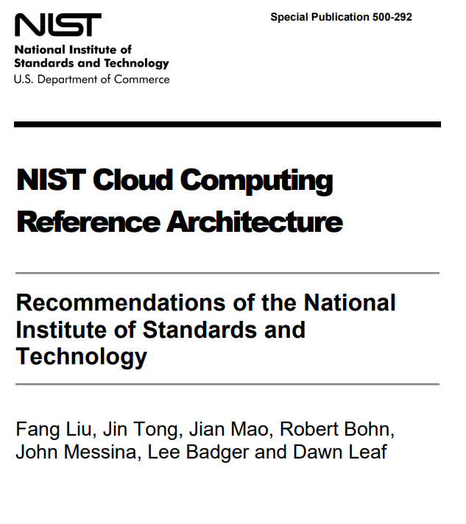
CRRA developed by NIST
NIST - National Institute of Standards and Technology
SP 800-145: The NIST Definition of Cloud Computing
SP 800-146: Cloud Computing Synopsis and Recommendations
SP 500-292: NIST Cloud Computing Reference Architecture

Slide 109
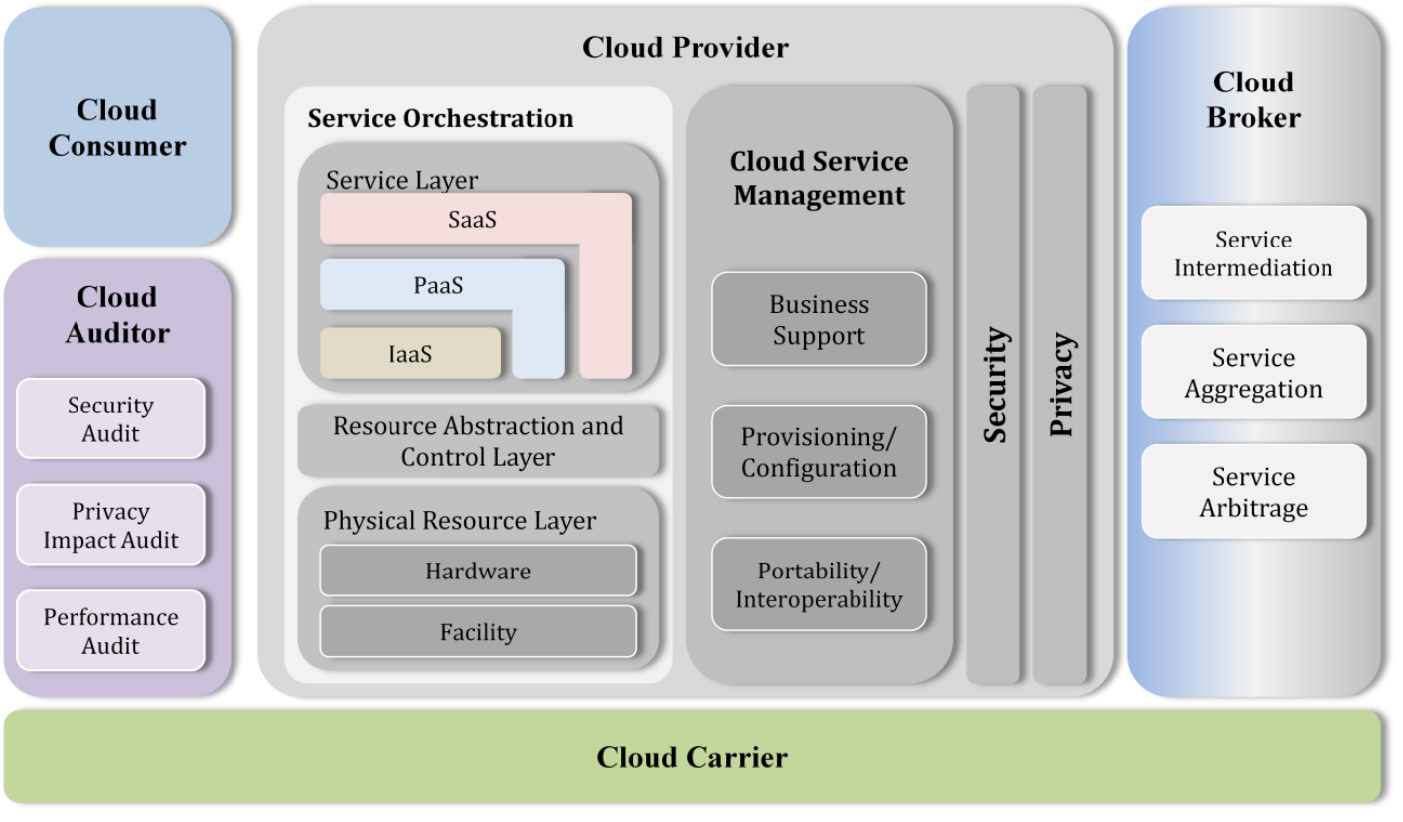
Overview of NIST CCRA

Slide 110
CCRA developed by ISO
ISO/IEC 17789:2014, Cloud computing – Reference architecture
diagrams and descriptions of how various aspects of cloud computing relate to one another and includes cloud computing roles, activities and functional components and their relationships.
This standard was last reviewed and confirmed in 2021.

Slide 111
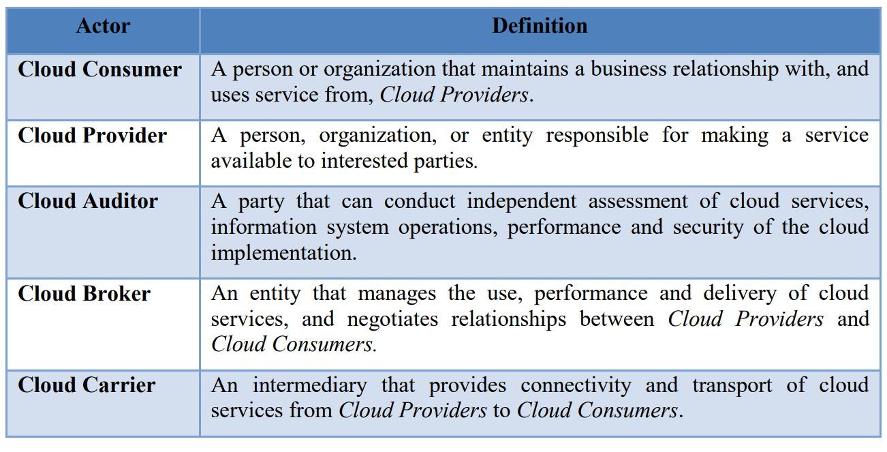
Cloud computing actors

Slide 112
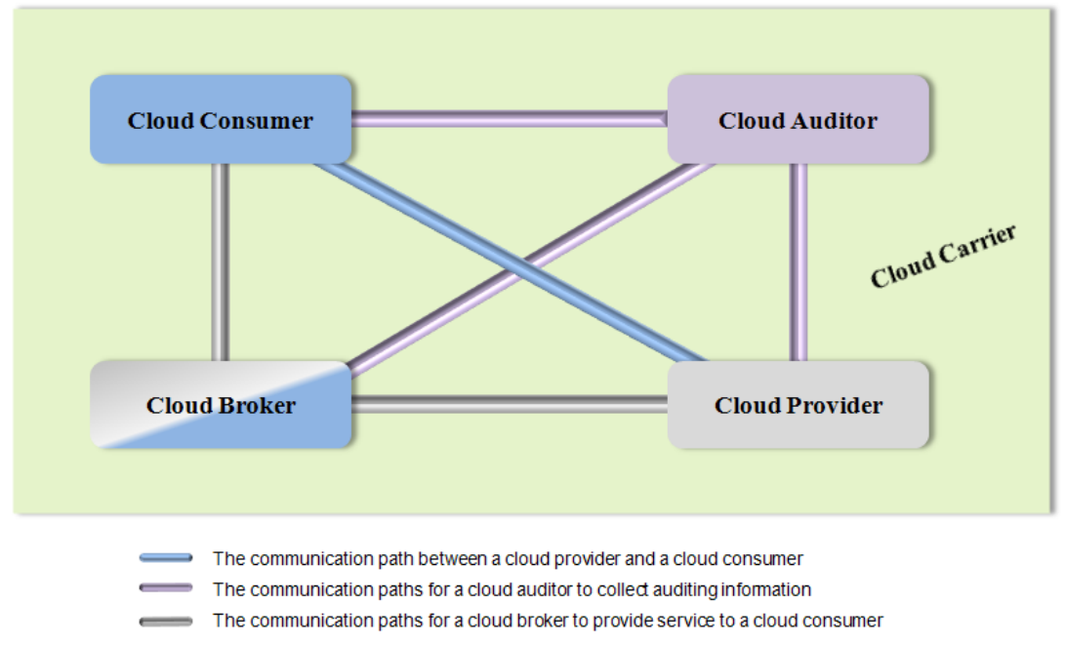
Interactions between the actors

Slide 113
Importance of foundational standards
Two foundational standards that deal with vocabulary and reference architecture
ISO/IEC 17788:2014 “Information technology — Cloud computing — Overview and vocabulary”
ISO/IEC 17789:2014 “Information technology — Cloud computing — Reference architecture”.
Essential for developing other standards

Slide 114
Cloud Computing Reference Architecture
Defines the basic building blocks—architectural elements and their relationships—which make up the cloud
Cloud computing roles
Cloud computing activities
Cloud computing functional components and their relationships

Slide 115
CCRA developed by ISO
ISO/IEC 17789:2014, Cloud computing – Reference architecture
diagrams and descriptions of how various aspects of cloud computing relate to one another and includes cloud computing roles, activities and functional components and their relationships.
This standard was last reviewed and confirmed in 2021.

Slide 116
Service deployment models
A cloud infrastructure may be operated in one of the following deployment models
public cloud
private cloud
community cloud
hybrid cloud
The differences are based on how exclusive the computing resources are made to a Cloud Consumer

Slide 117
Public cloud
A cloud in which the cloud infrastructure and computing resources are made available to the general public over a public network
Owned by an organization selling cloud services, and serves a diverse pool of clients

Slide 118
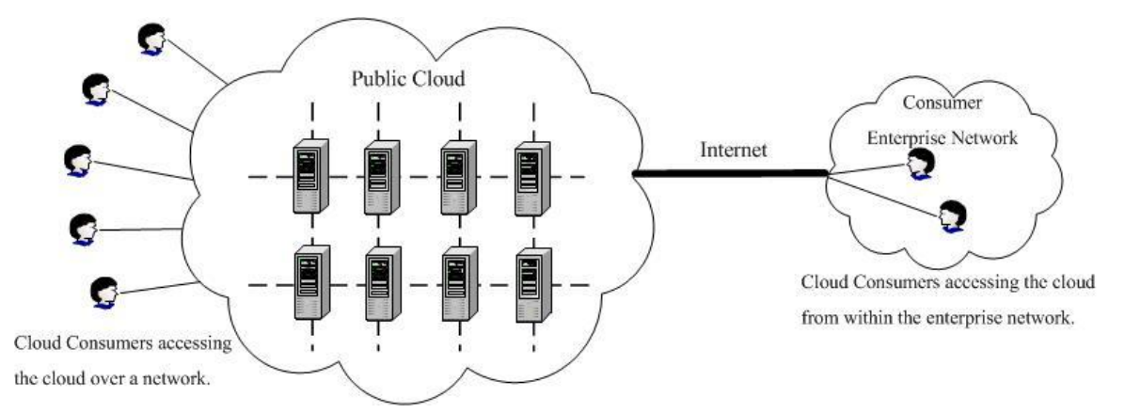
Public cloud

Slide 119
Private cloud
A cloud that gives a single Cloud Consumer’s organization the exclusive access to and usage of the infrastructure and computational resources
It may be managed either by the Cloud Consumer organization or by a third party
on-site private clouds - hosted on the organization’s premises
outsourced private clouds - outsourced to a hosting company

Slide 120
On-site private cloud
Hosted on the organization’s premises

Slide 121
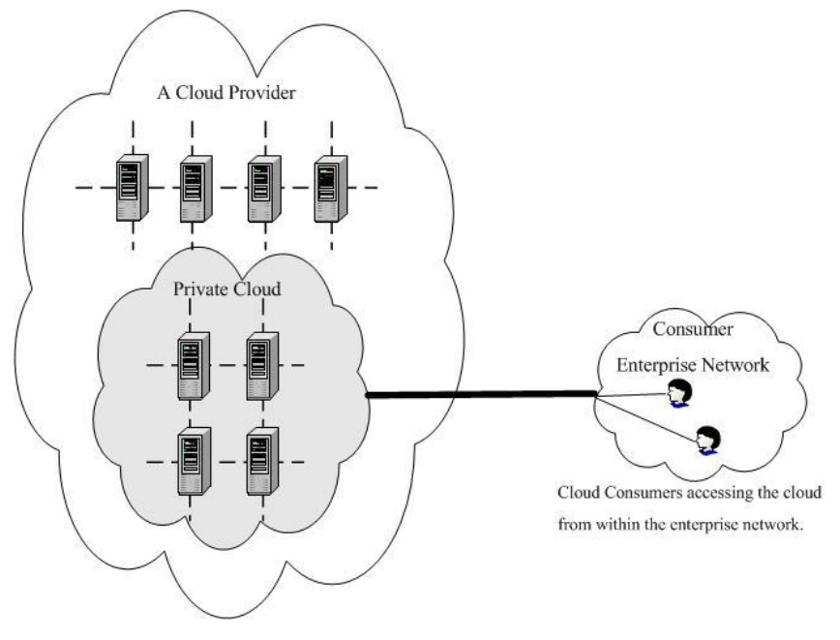
Outsourced private cloud
Outsourced to a hosting company

Slide 122
Summary (1)
Standardization of cloud computing
Standards ensure that goods or services produced in a specific industry come with consistent quality
Many standards and specifications related to Cloud Computing have been developed by standards developing organizations
Foundational standards that deal with vocabulary and reference architecture are essential for developing other standards

Slide 123
Summary (2)
Cloud Computing Reference Architecture
Cloud Computing Reference standard defines the basic building blocks—architectural elements and their relationships—which make up the cloud
Cloud computing reference models were proposed by multiple cloud organizations and standard setting bodies

Slide 124
Summary (3)
Cloud computing standards and laws in China
China has developed a number of standards and laws that regulate the adoption of cloud computing technology in different aspects (security, privacy, financial and others)
Chinese parties collaborate with international standard setting bodies

